Slide 1
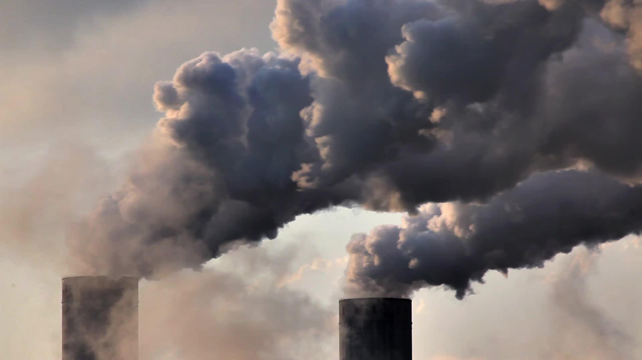
Climate Change: The Solution
A Team
National University
ANA 699A
Notes:
Adam, just a title slide

Slide 2
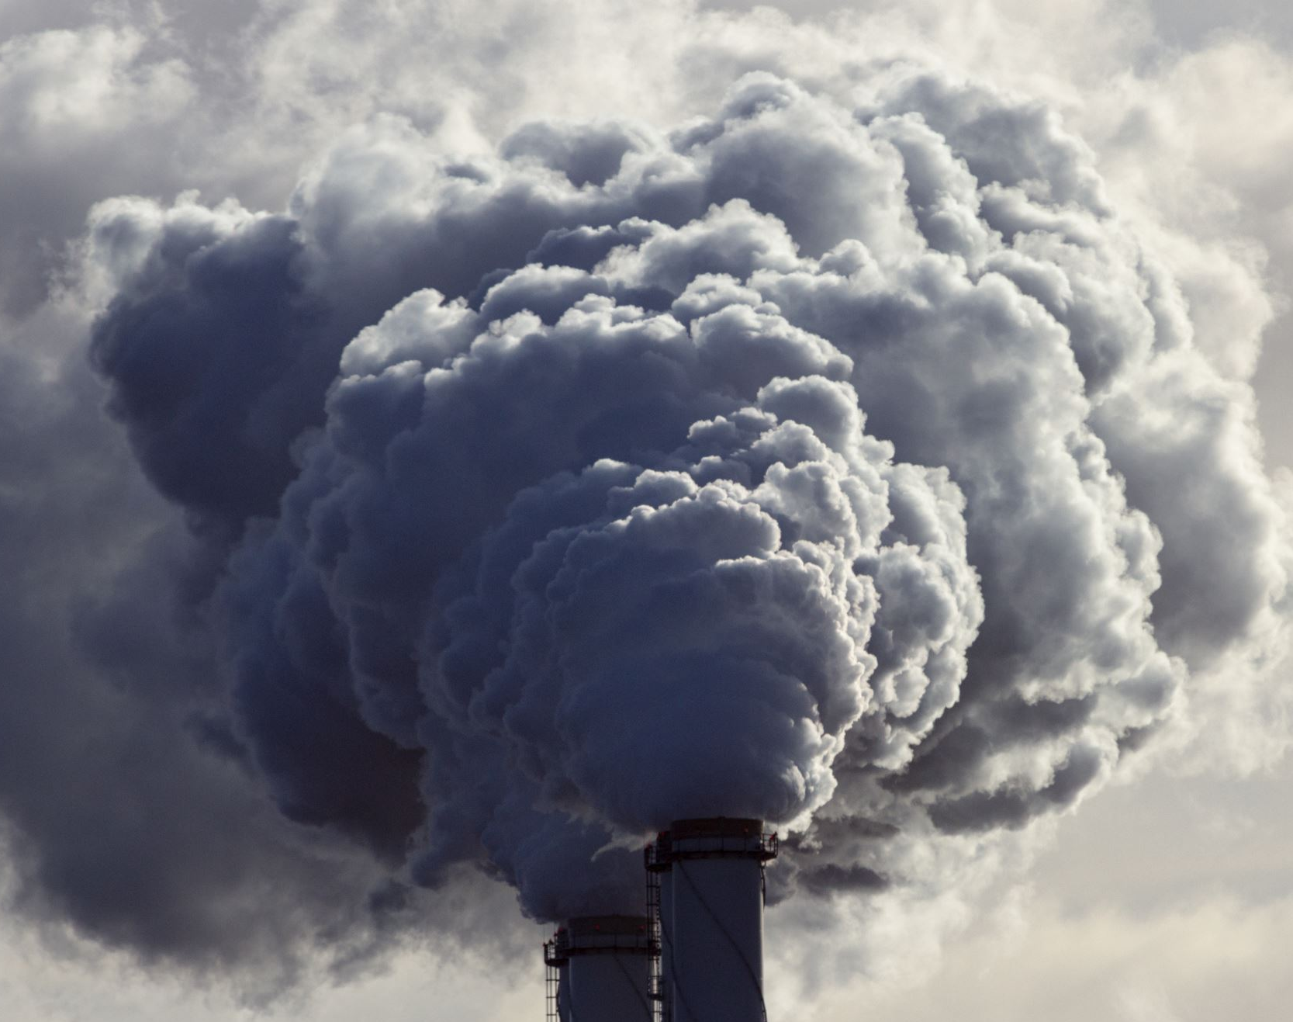
How will measures to cut carbon emissions in Southern California affect current lives in terms of cost?
Notes:
Adam

Slide 3
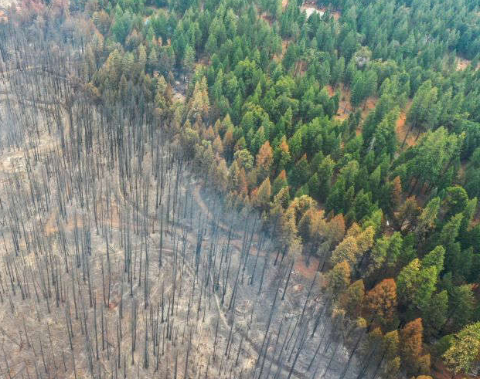
Southern California is experiencing wildfires at an increased rate and severity.
Notes:
Adam

Slide 4
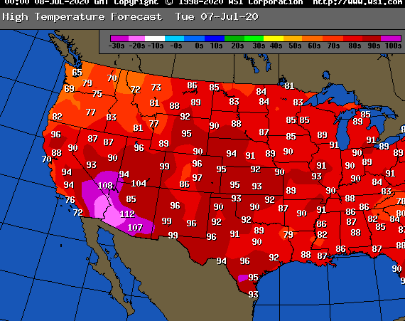
Southern California's energy grid is under hyper stress from an enduring heat wave.
Notes:
Adam

Slide 5
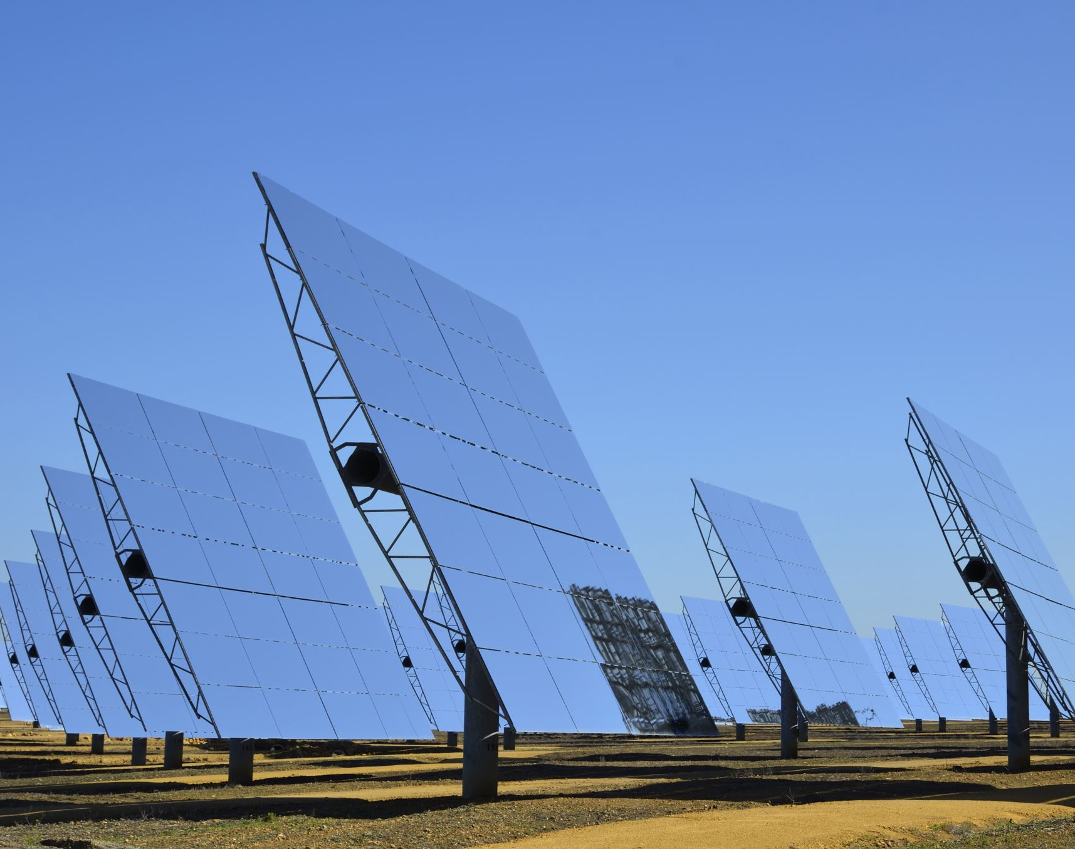
Southern California enacted a series of energy saving methods to keep the energy grid from overloading.
Notes:
Adam

Slide 6
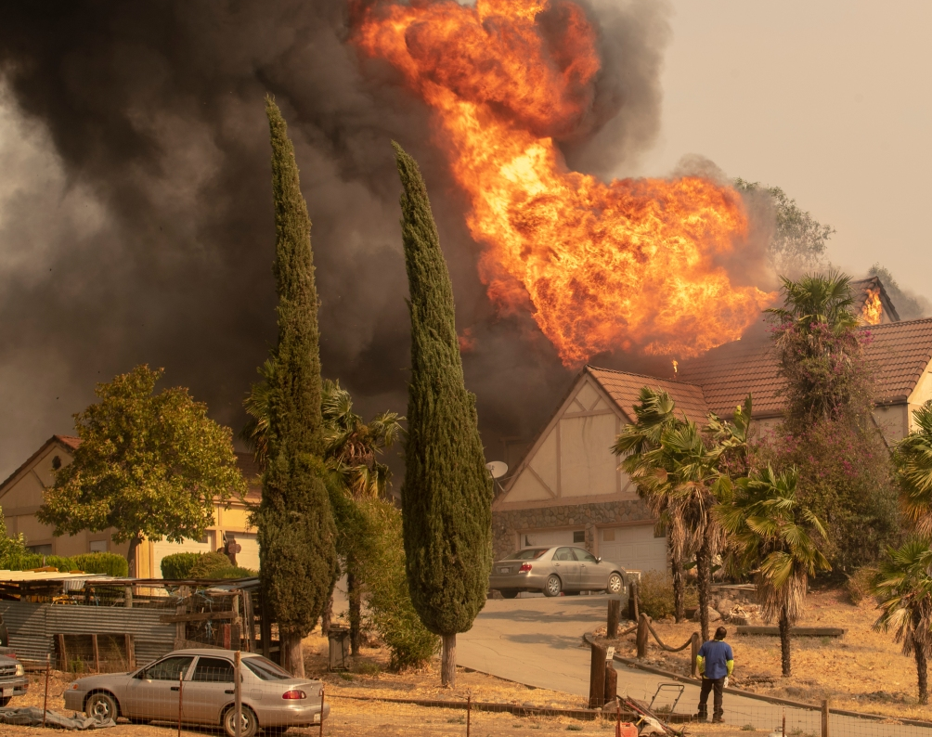
The Southern California population is dealing with the fallout of the wildfires.
Notes:
Adam

Slide 7
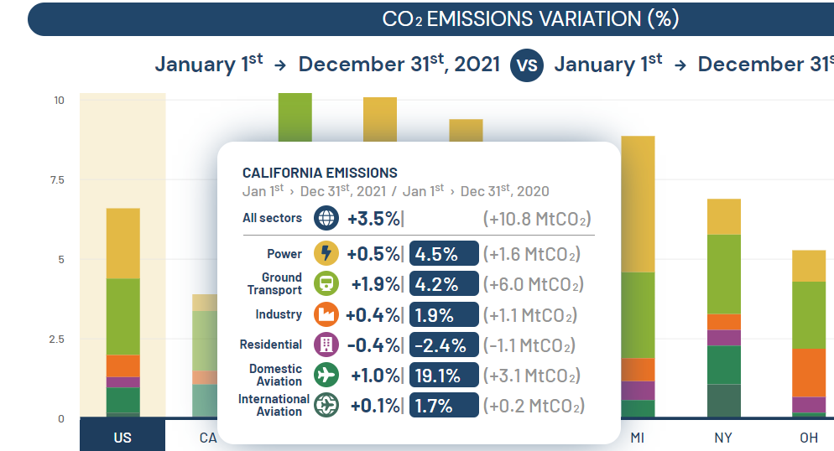

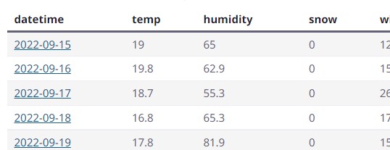


Collecting data related to CO2 emission and daily weather in southern California
Notes:
Carbon Emissions : High energy used and dense population – the city is a CO2 Hotspot.
(eia) energy information administration - CO2 emission data from electricity generation by plant and by region
The U.S. Carbo Monitor : daily CO₂ emissions of individual U.S. states, data available from 2019
The U.S. Carbon Monitor : daily CO₂ emissions of individual U.S. states, data available from 2019
Weather data:
California Environmental Conditions Dataset : Kaggle
California Weather 2019 : Kaggle

Slide 8

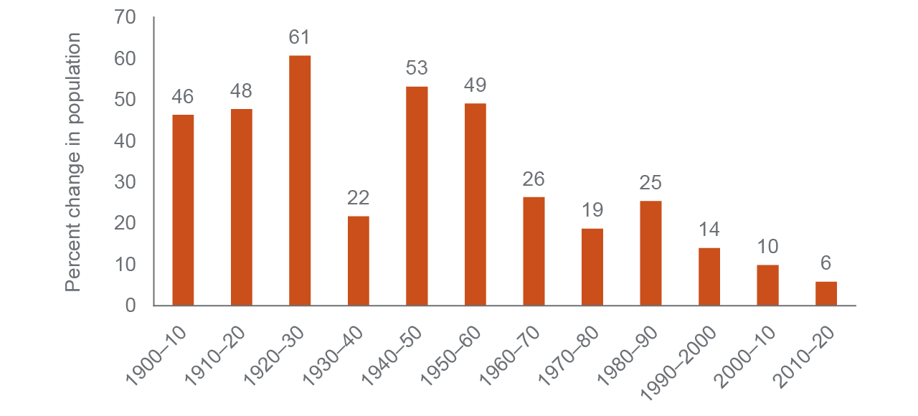
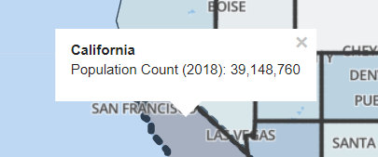


California’s population growth has slowed dramatically in recent decades.
CA Living Wage data
Resident Population in California
Notes:
CA Living Wage: CHHS open data
Resident Population in California (CAPOP) Fred Economic data

Slide 9





The creation of a data warehouse will enable data analytics.
To Design database
Notes:
We plan to design and build a database to analyze the data once we complete data cleaning and mining processes.
We have selected oracle database to store and oracle sql to access this data.

Slide 10


Machine learning and statistical analysis will utilize Linear Regression, Random Forests, and Clustering models.

Slide 11
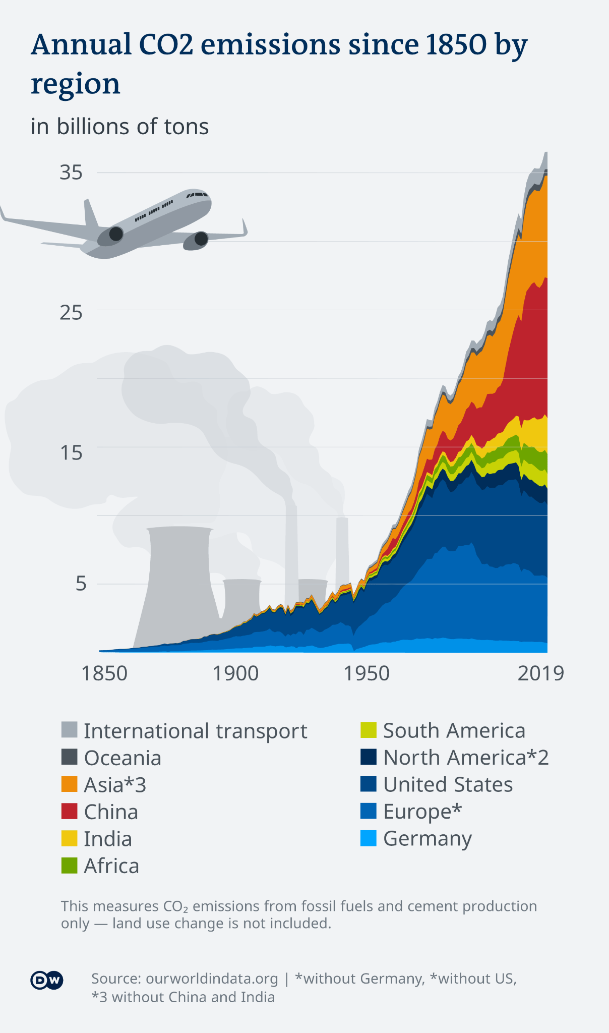

Area map used to show the dramatic decline of Carbon Emission in United States and Europe.

Slide 12
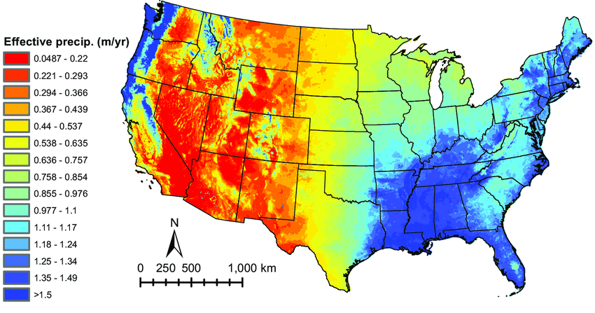
Weather data will be evaluated to identify historical trends and regions with highest drought.

Slide 13

The A Team advisor and sponsor.
Notes:
Aakriti –
Dr. Barbara Lauridsen - Advisor - Data Warehouse Design and Development
Dr. Jed Baker - Advisor/Sponsor - Data Mining Techniques & Data Mining and Machine Learning

Slide 14

The meeting schedule and outcomes.
Notes:
Aakriti –
For our Advisor and sponsor its still tbd, but once a week.
Group - Tuesday/Thursday 5:30pm to 6:30pm pst. Weekends and reschedules as needed. We have 3 different time zones.
Our plan is to initially meet on tuesday and make sure to have those deliverables by Thursday

Slide 15

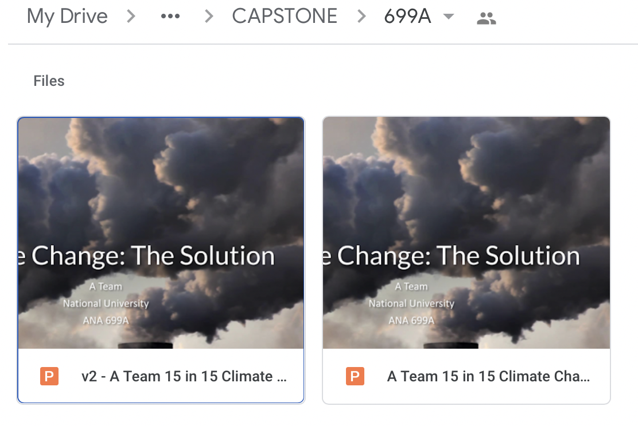


Information sharing plan.
Notes:
Aakriti –
Of course, even on the days we don’t meet. we are communicating pretty regularly. Most of comm. involves text, slack, and zoom.
One of the easiest way for us to collaborate is google docs and drive, as updates can be made in real time. We already have a shared folder for this class in between us as seen here. And we will sending finalized versions fo the files to each other to have as a backup.

Slide 16
References
Historical temperature trends in Los Angeles County, California. University of Southern California. (n.d.). Retrieved September 16, 2022, from https://doi.org/10.25549/USCTHESES-C3-525371
Hore, A. (2022, March 23). Carbon dioxide emissions of the world( 1990-2018). Kaggle. Retrieved September 16, 2022, from https://www.kaggle.com/datasets/ankanhore545/carbon-dioxide-emissions-of-the-world
Living wage. California Health and Human Services Open Data Portal. (2020, October 1). Retrieved September 16, 2022, from https://data.chhs.ca.gov/dataset/living-wage
Resident population in California. FRED. (2021, December 22). Retrieved September 16, 2022, from https://fred.stlouisfed.org/series/CAPOP
Shuja, A. (2021, May 5). California weather 2019. Kaggle. Retrieved September 16, 2022, from https://www.kaggle.com/datasets/ahmedshuja/california-weather-2019
U.S. Energy Information Administration - EIA - independent statistics and analysis. Emissions by plant and by region. (n.d.). Retrieved September 16, 2022, from https://www.eia.gov/electricity/data/emissions/
Us Carbon Monitor. Carbon monitor. (n.d.). Retrieved September 16, 2022, from https://us.carbonmonitor.org/
Hans J., Eric M., MArisol M. California’s population, from https://www.ppic.org/publication/californias-population/
Zaloumis, C. (2020, October 2). California Environmental Conditions Dataset. Kaggle. Retrieved September 16, 2022, from https://www.kaggle.com/datasets/chelseazaloumis/cimis-dataset-with-fire-target
Notes:
And here are some of the references we used, looking for these datasets and articles is still an ongoing process and we hope to find more relevant sources. Thank you!

